Slide 1
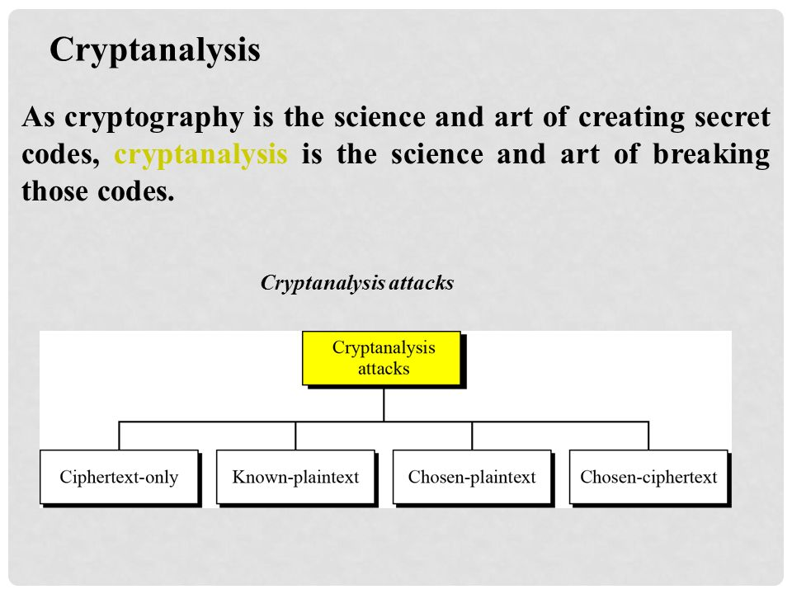

Slide 2
Ciphertext-Only Attack (COA)
In cryptography, a ciphertext-only attack (COA) or known ciphertext attack is an attack model for cryptanalysis where the attacker is assumed to have access only to a set of ciphertexts.
The attack is completely successful if the corresponding plaintexts can be deduced (extracted) or, even better, the key.
The ability to obtain any amount of information from the underlying ciphertext is considered a success.

Slide 3
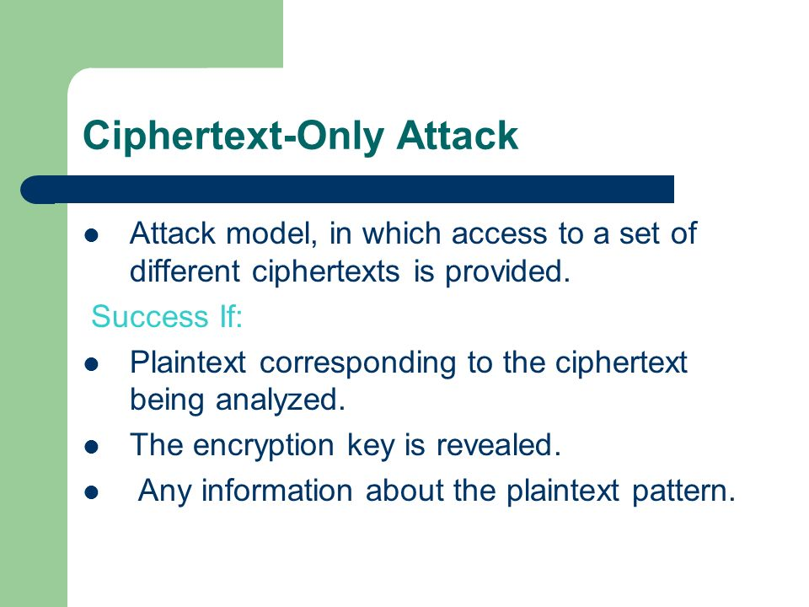

Slide 4
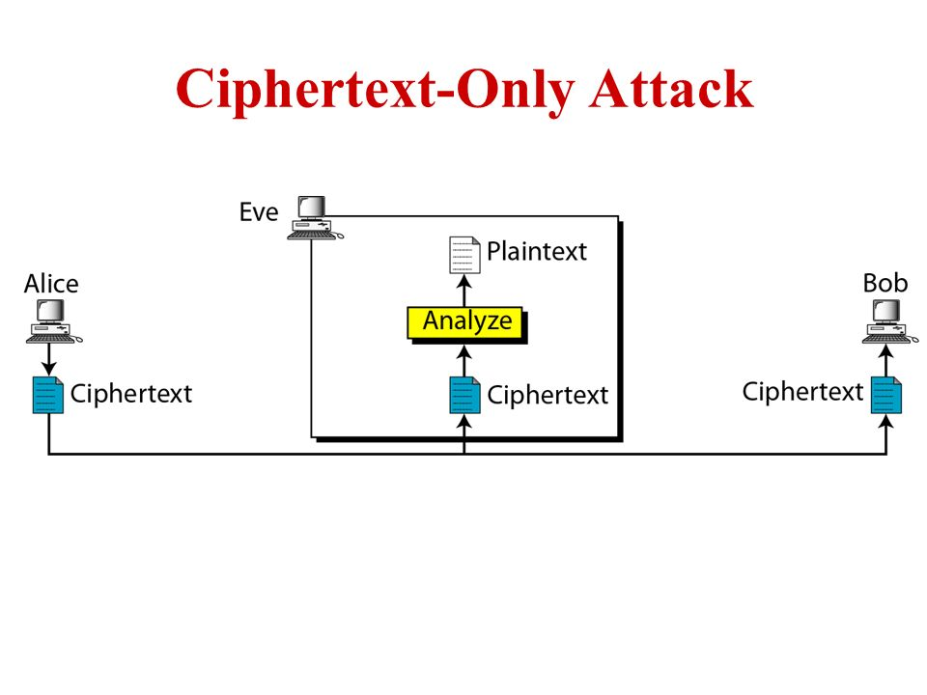

Slide 5
Known-Plaintext Attack (KPA)
The known-plaintext attack (KPA) is an attack model for cryptanalysis where the attacker has access to both the plaintext, and ciphertext
These can be used to reveal further secret information such as secret keys

Slide 6
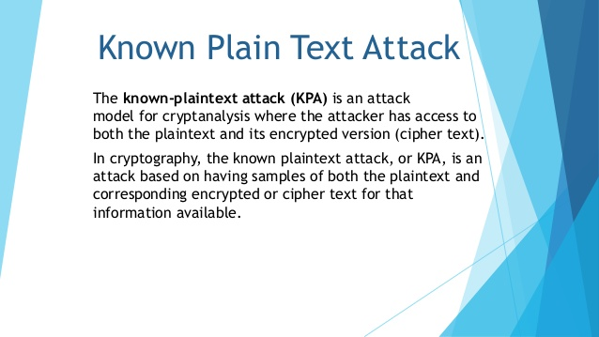

Slide 7
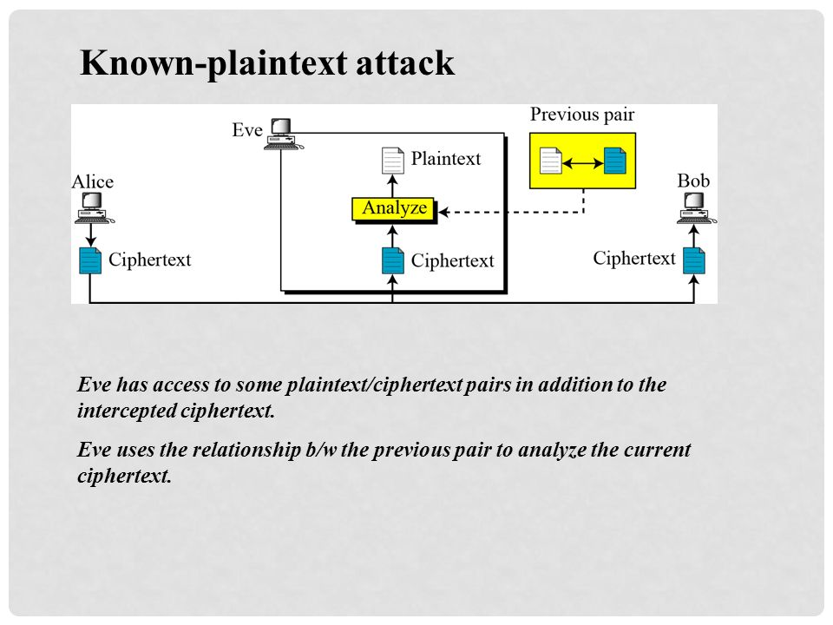

Slide 8
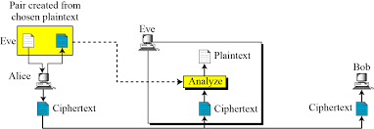
Chosen plaintext attack
The chosen plaintext attack is similar to the known plaintext attack, but the plaintext/cipher text pairs have been chosen by the attacker herself
Example:
If attacker access to alice computer. She can choose some plaintext and intercept the created cipher text. Of course she does not the key because the key is normally embedded in the software used by the sender.

Slide 9
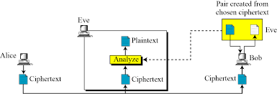
Chosen Cipher text attack
It is similar to the chosen plaintext attack, except that eve chooses some cipher text and decrypt it to form a Ciphertext/Plaintext pair.
This can happen if Eve has access to Bob computer.

